Slide 1
AI Impact on Jobs & Layoff Risk Analysis
Prepared by
Maha Mostafa

Slide 2
Project Overview:
The aim of this project is to analyze how Artificial Intelligence adoption affects jobs, employee responsibilities, and layoff risk. The project uses Python for data cleaning and Power BI for visualization and analysis.

Slide 3
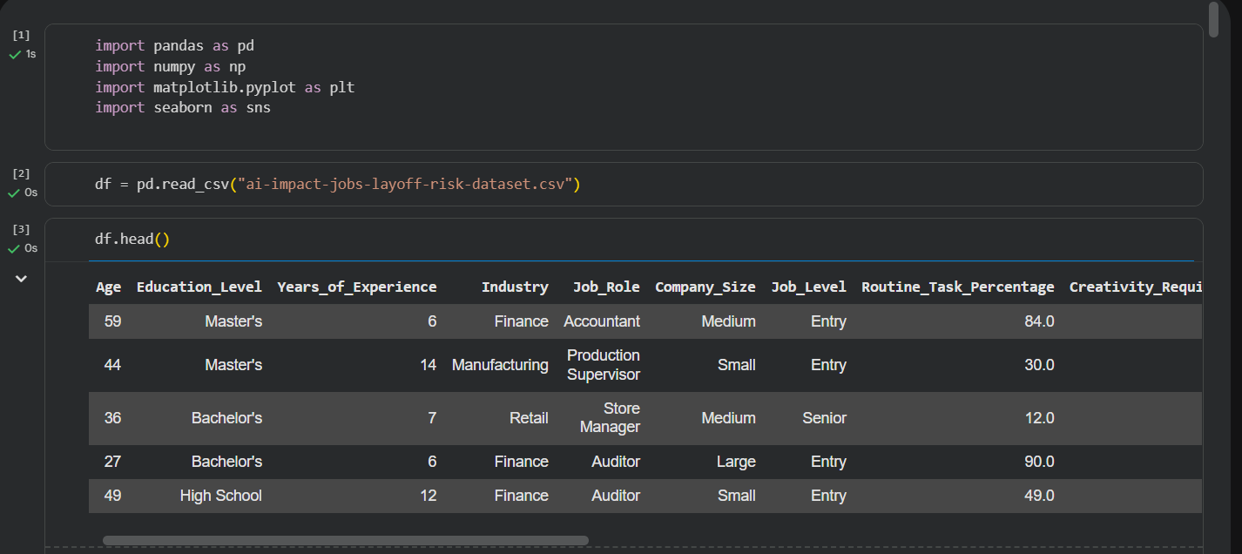
Data Includes:
Employee Information
Company Information
AI Adoption
AI Usage
AI Training
Layoff Risk
Import libraries and Show the first five rows

Slide 4
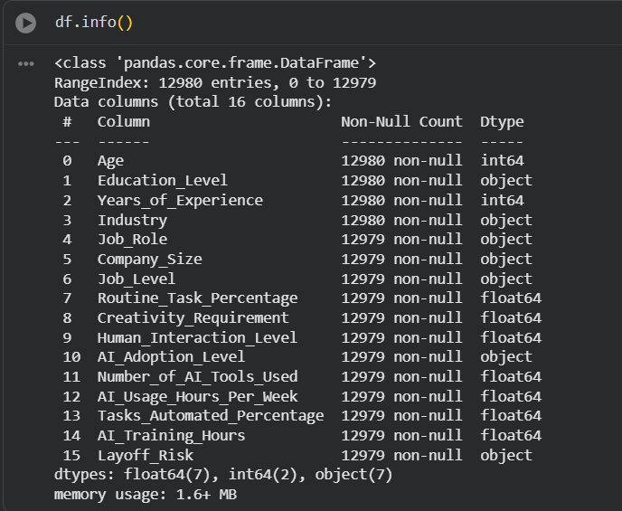
Dataset Information
Used to check the data types and dataset structure
Number of Records: 12979
Number of Columns: 16
Data contains:
Employee Information
Company Information
AI Usage
AI Training
Layoff Risk

Slide 5
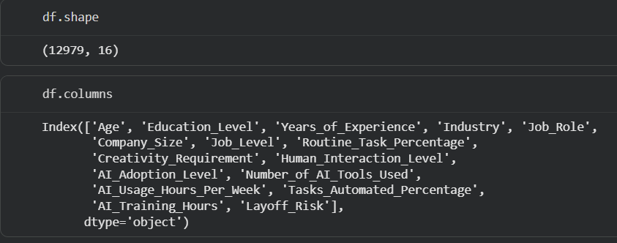
Information about columns
Examined the dataset structure by identifying its dimensions and reviewing all column names before starting the analysis.

Slide 6

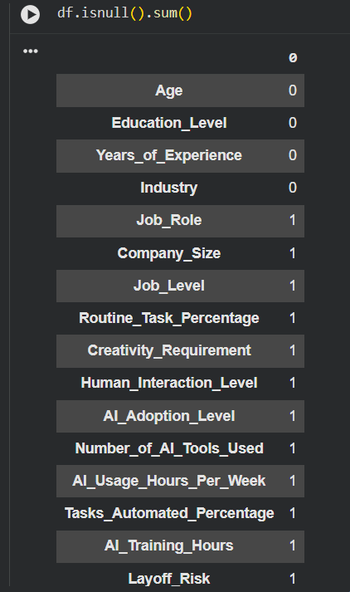
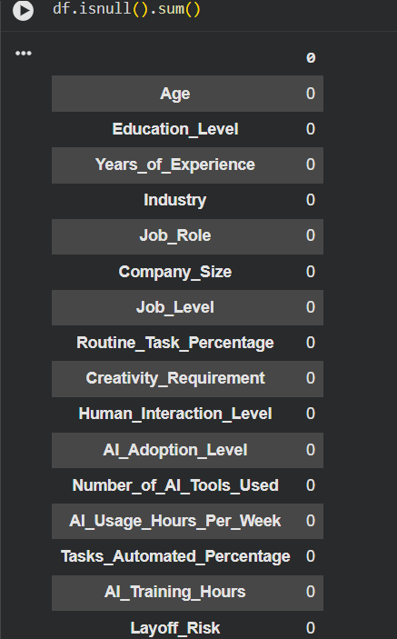
Data Cleaning:
After removing null values
Checks missing values in every column
IS.NULL():
Verified data completeness by checking missing values across all columns. Only a few missing records were identified and handled.

Slide 7
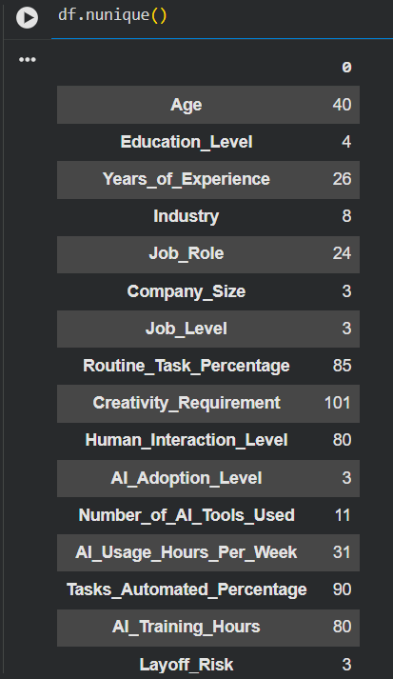

Data Cleaning:
Check number of unique values
Duplicated() & Unique():
checked for duplicated records and
analyzed the number of unique values
in each column.
no duplicated records were found , and
unique values were identified to better
understand the dataset
Checks duplicate records

Slide 8
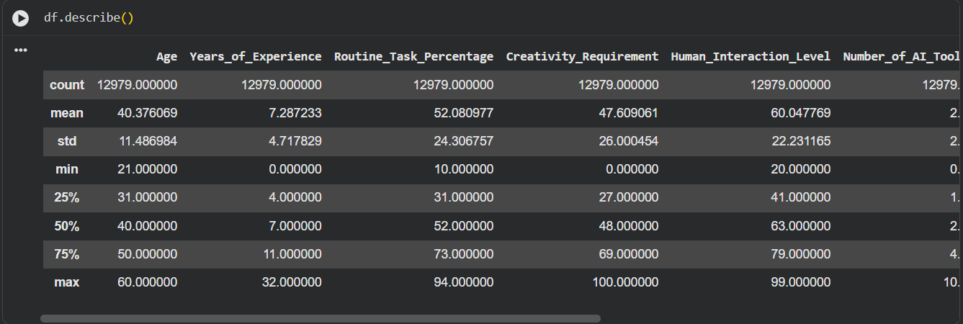
Data Cleaning:
Shows statistical summary of numerical columns
Describe():
Generated a statistical summary of numerical features to understand data distribution , central tendency, and variability.

Slide 9
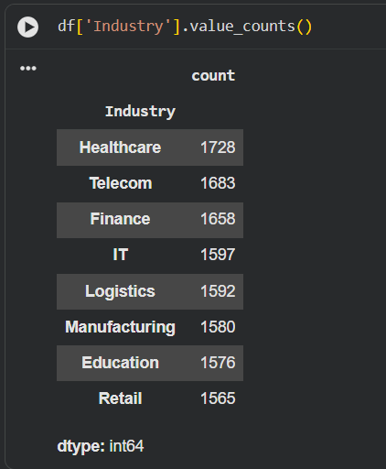
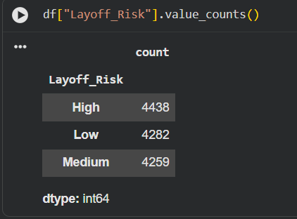
Exploratory Data Analysis (EDA)
Analyzed the distribution of categorical variables by counting the frequency of each category to understand the dataset composition.

Slide 10
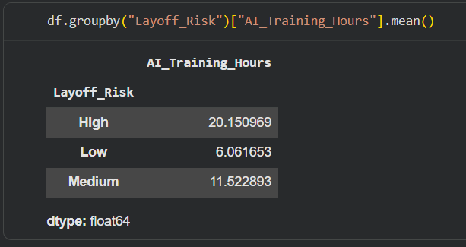
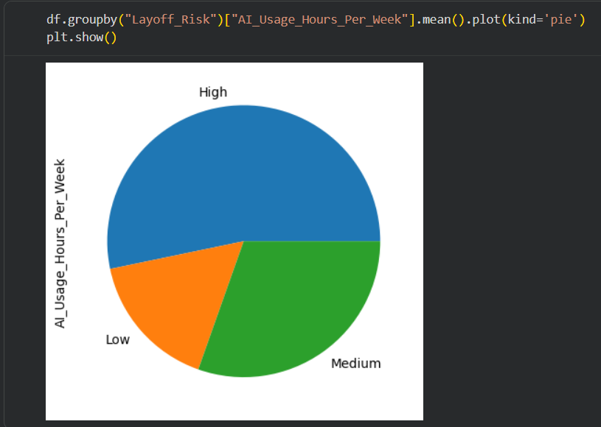
Exploratory Data Analysis (EDA)
Compared the average AI training hours and AI usage across different layoff risk levels to identify patterns and relationships.

Slide 11
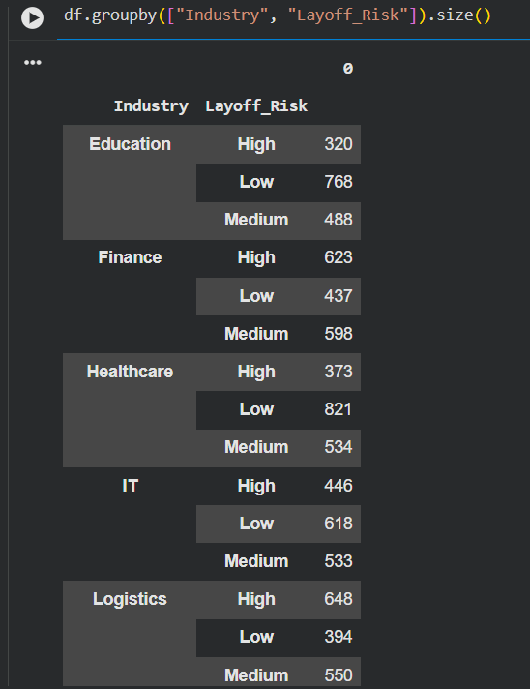
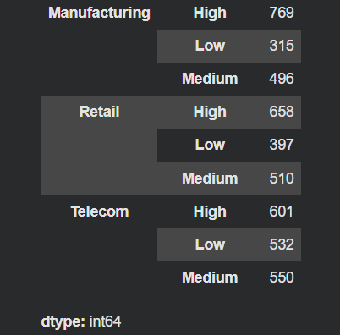
Exploratory Data Analysis (EDA)
Grouped the data by industry and layoff risk to analyze the distribution of employees across different risk levels.

